Slide 1



AI Collaboration Mini-Course
Sean Wong
2025/08/05

Slide 2
Contents
01.
02.
03.
Launch & Mindset
AI Fundamentals
How AI Learns
04.
05.
06.
AI Around You
Collaborate Smartly
Ethics & Responsibility

Slide 3
Contents
01.
02.
Build Your Practice
Capstone & Next Steps

Slide 4



Launch & Mindset
01

Slide 5


Welcome & Objectives
Course Goals
Welcome to the AI Collaboration Mini-Course! This 8-hour journey aims to shift your mindset from fearing AI to effectively partnering with it. We'll cover AI fundamentals, ethics, and practical collaboration strategies.
Active Participation
Engage actively through discussions, hands-on exercises, and reflections. This course is designed to be interactive, ensuring you gain practical skills and insights applicable in your professional and personal life.
Personal Relevance
Whether you're a professional, student, or lifelong learner, this course will help you understand how AI can enhance your work and daily routines. Let's explore AI together!

Slide 6

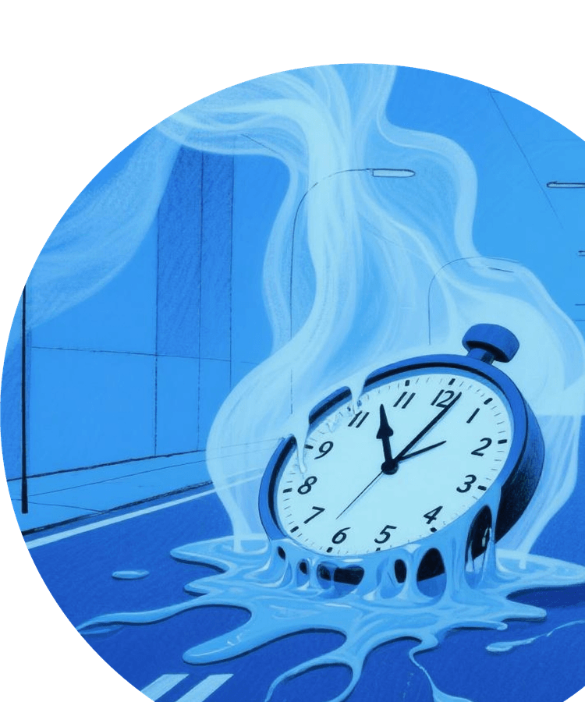
Pre-Course Survey Insights
Survey Overview
We conducted a pre-course survey to understand your prior AI experience, hopes, and concerns. Here are some anonymised insights: Participants range from AI novices to those with intermediate knowledge.
Diverse Expectations
Common hopes include learning practical AI applications, understanding ethical considerations, and improving productivity. We'll address these needs throughout the course.

Slide 7



Tool Setup Checklist
Coding Copilot
Choose a coding copilot tool and create an account. Install necessary extensions and configure settings for optimal performance.
ChatGPT
Technical Readiness
Create a free account on ChatGPT. Ensure you have the latest browser version and any required plug-ins installed. Set up privacy settings to protect your data.
Ensure all tools are set up correctly before Module 1. Technical readiness is key to a smooth learning experience.
Set up DALL·E
Sign up for DALL·E to explore AI-generated images. Follow the setup instructions to ensure seamless integration with your workflow.

Slide 8
AI Fundamentals
02

Slide 9


What Counts as AI?
Types of AI
AI can be categorised into Narrow AI, which performs specific tasks; General AI, capable of human-like intelligence; and Superintelligent AI, which surpasses human capabilities.
Realistic Expectations
Today's AI tools are mostly Narrow AI, designed for specific applications. Understanding these distinctions sets realistic expectations for our collaboration.

Slide 10


Milestones That Matter
Historical Milestones
From the Turing Test to modern breakthroughs, AI has evolved significantly. Key milestones include expert systems and ImageNet, which accelerated AI development.
Acceleration Since 2012
The past decade has seen rapid advancements, making AI ubiquitous. Understanding these milestones helps contextualise today's AI landscape.
Practical Implications
These milestones highlight AI's potential and limitations. As we explore AI, keep in mind how far it has come and where it might go.

Slide 11
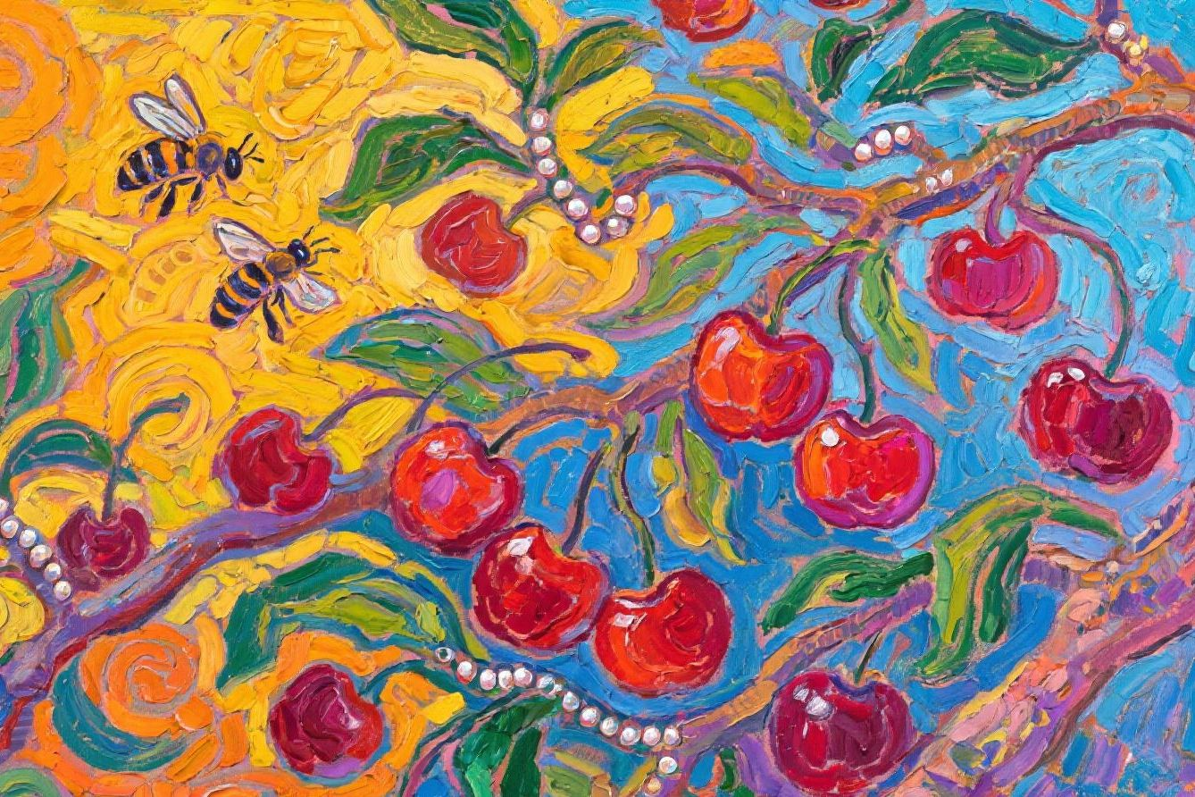
Daily AI Spotting Game
Spotting AI
Before lunch, list 10 invisible AI touches in your daily life, such as spam filters, map rerouting, and predictive text. This exercise builds awareness and personal connection to AI.

Slide 12
How AI Learns
03

Slide 13


Pipeline Overview
Machine Learning Pipeline
AI learning involves data collection, training, validation, and deployment. Each step is crucial for model performance.
Quality Data
High-quality data ensures accurate model training. Human oversight is vital to guide and refine AI models.
Ethics Connection
Understanding the pipeline highlights the importance of ethical data practices, setting the stage for our upcoming ethics discussions.

Slide 14

Neural Networks Demystified
Neural Network Basics
Neural networks consist of neurons, layers, and weights. They mimic the human brain to find complex patterns in data.
Pattern Recognition
These networks excel at identifying patterns too intricate for explicit coding, making them powerful tools for AI applications.

Slide 15

Limits & Failure Modes
Bias Amplification
AI can amplify biases present in training data, leading to unfair outcomes. Vigilance is required to mitigate this risk.
Overfitting
Overfitting occurs when a model learns training data too well, failing to generalise to new data. This limits its real-world applicability.
Hallucination
AI hallucination generates incorrect or nonsensical outputs. Understanding these failure modes helps in using AI responsibly.
Human Oversight
Human scepticism and iterative refinement are crucial when collaborating with AI to address these limitations.

Slide 16
AI Around You
04

Slide 17

Sector Snapshots
Healthcare
In healthcare, AI assists with radiology image tagging, improving diagnostic accuracy and efficiency.
Finance
AI powers credit-card fraud alerts, detecting unusual transactions in real-time to protect users.
Education
Adaptive learning apps use AI to personalise education, enhancing student engagement and outcomes.

Slide 18

Personal AI Audit Results
Audit Insights
Our audit revealed common AI touchpoints like email autocomplete, route optimisation, and smart replies. These tools are integral to daily life.
Reflection
Reflect on your dependency on AI. Understanding its ubiquity helps in making informed decisions about its use.

Slide 19

Hidden Influence Dangers
Filter Bubbles
AI creates filter bubbles, limiting exposure to diverse viewpoints and reinforcing existing beliefs.
Dark Patterns
AI-driven dark patterns subtly nudge users towards certain actions, potentially compromising autonomy.
Surveillance Pricing
AI enables surveillance pricing, where prices are adjusted based on user data, raising ethical concerns.
Critical Thinking
Develop critical thinking to navigate these influences and maintain control over your digital experiences.

Slide 20
Collaborate Smartly
05

Slide 21

Prompt Engineering Basics
Context Setting
Set the context for AI tasks to ensure accurate and relevant outputs. This foundational step guides the AI's understanding.
Role Assignment
Assign roles to AI, specifying its function in the task. This clarifies expectations and enhances collaboration.
Iterative Refinement
Refine prompts iteratively to improve AI responses. This process optimises outcomes and ensures alignment with goals.

Slide 22



Task Mapping
Practical Application
Map tasks on axes of creativity, speed, accuracy, and empathy. This matrix helps identify tasks best suited for AI or human collaboration.
Use the matrix to prioritise tasks for AI assistance, ensuring efficient and effective collaboration.
Human-AI Task Fit Matrix

Slide 23

Sandbox Challenge
Challenge Overview
In this 10-minute challenge, generate three slogan options for a fictional eco-product using AI.
Iterative Process
Iterate twice using feedback to refine the slogans. This exercise demonstrates the impact of phrasing on AI outputs.
Comparison
Compare results from different iterations to see how prompt engineering enhances outcomes.
Reflection
Reflect on the phrasing impact and how iterative refinement improves AI collaboration.

Slide 24
Ethics & Responsibility
06

Slide 25


Bias Pathways
Bias Origins
Bias in AI stems from historical data, labelling choices, and deployment contexts. These factors can embed sexism, racism, or ageism into models.
Case Study
Mitigation
A recruiting tool case study illustrates how bias in AI can have real-world consequences, highlighting the need for vigilance.
Understanding bias pathways is crucial for developing strategies to mitigate its impact in AI systems.

Slide 26


Accountability Framework
NIST AI RMF
Introduce the NIST AI Risk Management Framework: govern, map, measure, manage. This framework provides a structured approach to accountability.
Template
Use a one-page template to assign roles for oversight, incident response, and continuous monitoring in your organisation.

Slide 27



Privacy & Consent
Model Memorisation
Opt-Out Limitations
AI models can memorise data, posing privacy risks. Be cautious about the data you input.
Understand the limitations of opt-out options in AI systems to make informed decisions.
Prompt Leakage
Best Practices
Prompt leakage can expose sensitive information. Ensure prompts are anonymised to protect privacy.
Use local models when feasible and read Terms of Service to safeguard privacy.

Slide 28
Build Your Practice
07

Slide 29

Workflow Integration Canvas
Canvas Overview
Use the Workflow Integration Canvas to map task frequency, pain level, AI suitability, and risk tolerance.
Pilot Project
Prioritise one pilot project for post-course adoption, ensuring a realistic scope for integration.

Slide 30


Weekly Reflection
Adopt weekly reflection questions to track your AI practice and identify areas for improvement.
Output Logs
Habit Tracking Plan
Maintain output logs to document your AI experiments and measure their effectiveness.
Metric Choices
Choose metrics like time saved or quality score to evaluate the impact of AI on your workflow.

Slide 31



Generative & Agentic AI
AI Types
Clarify the difference between content-creating generative AI and autonomous agentic AI that chains actions. Demonstrate a simple agent to highlight guardrail needs.

Slide 32
Capstone & Next Steps
08

Slide 33
Project Gallery Kickoff
Capstone Requirements
Define a goal, select AI tools, document iterations, and present results for your capstone project.
Inspiration
Watch a two-minute video of a past learner creating an AI-assisted lesson plan to spark creativity and ideas.
Guidance
Follow the outlined steps to ensure a structured and successful capstone experience.

Slide 34
Mindset Shift
Course Feedback
Reflect on the biggest mindset shift you experienced during the course and any remaining fears or concerns.
Provide course feedback via QR code to help us improve materials and facilitation for future learners.
Reflection & Feedback

Slide 35



Keep Learning Pathway
AI Journal
Maintain an AI journal to document your ongoing experiments and insights.
Workflow Upgrades
Resources
Revisit your workflow canvas every six months to integrate new AI tools and techniques.
Explore curated newsletters, MOOCs, community forums, and policy trackers to continue your AI learning journey.
Regular Check-ins
Join quarterly reunion webinars to stay updated and connected with fellow learners.

Slide 36

Thank You
Sean Wong
2025/08/05

